Slide 1

Exploratory Data Afialysis
Descriptive Statistics & Outliers
DATA ANALYTICS

Slide 2
Table of Contents
Part I: Introduction and Univariate Analysis
What’s EDA
Key Concepts
Data types
EDA Framework
Univariate Analysis techniques
Part II: Bivariate Analysis and Outliers
Bivariate Analysis techniques
Atypical values (Outliers)

Slide 3

Bivariate Analysis
Exploring The Relationship and Interactions Between Two Variables in Depth

Slide 4
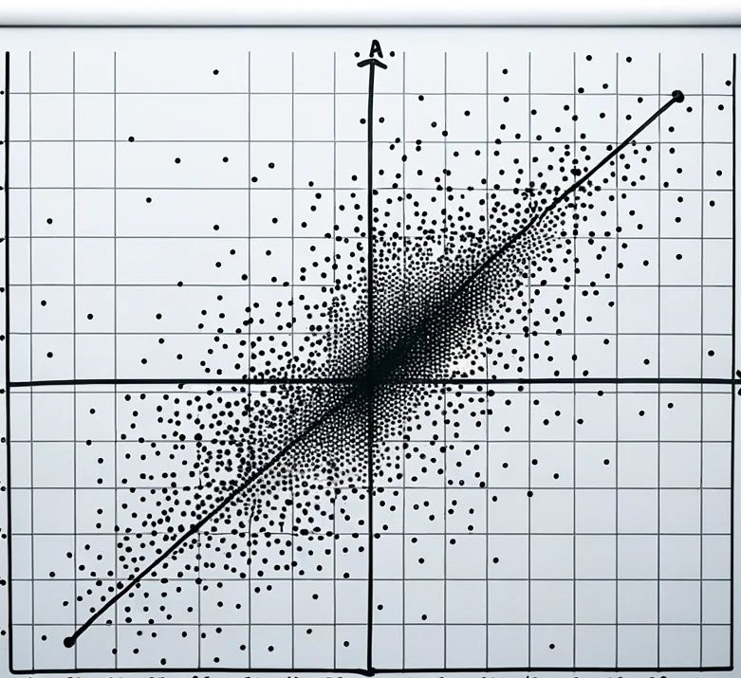
Bivariate Analysis
When working with two categorical variables, we focus on understanding the relationships and interactions between the categories.
When working with two numerical continuous variables, we aim to determine the strength and nature of the relationship between them.
When analyzing one categorical and one numerical variable together, we often look at how the numerical variable's central tendency and spread might differ across the different categories.

Slide 5
Bivariate Analysis
Categorical (or Discrete) Variables

Slide 6
Two Categorical or Discrete Variables
Contingency Tables or Cross-tabulation
Table that represents the frequency distribution of categories from both variables. Used to understand the relationship between two or more categorical variables.
Computes probabilities of the joint occurrence of two categorical variables.
It is often used in hypothesis testing to determine if the observed frequencies for categories differ from the expected frequencies, e.g., Chi-square tests.
Index | Gender | Drink
0 | Male | Tea
1 | Male | Coffee
2 | Male | Tea
3 | Male | Coffee
4 | Male | Coffee
5 | Female | Tea
6 | Female | Tea
7 | Female | Tea
8 | Female | Tea
9 | Female | Coffee
Rows: categories of one variable.
Columns: categories of another variable.
Cells: the count for a specific category combination.
Marginal frequencies: row and column totals. Total counts for one variable disregarding the other variable.
 | Coffee | Tea | Total
Female | 1 | 4 | 5
Male | 3 | 2 | 5
Total | 4 | 6 | 10

Slide 7
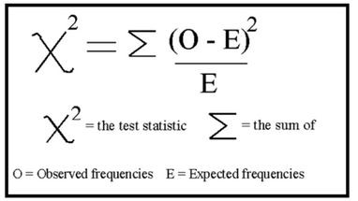

Two Categorical or Discrete Variables
Chi-square Test
Determines if there's a statistically significant association between the two categorical variables.
It compares:
Observed Frequencies in a Contingency Table: The actual counts in each cell of the table.
Expected Frequencies: What we would expect the counts in each cell to be if there were no relationship between the two variables (if the two variables were independent).
 | Coffee | Tea | Total
Female | 1 | 4 | 5
Male | 3 | 2 | 5
Total | 4 | 6 | 10
 | Coffee (Expected) | Tea (Expected) | Total
Female | 2.0 | 3.0 | 5.0
Male | 2.0 | 3.0 | 5.0
Total | 4.0 | 6.0 | 10.0

Slide 8
Two Categorical or Discrete Variables
Chi-square Test
Note: We'll delve deeper into the Chi-Square Test later; now, we're emphasizing its application and result interpretation. We'll use Python, especially the scipy library, for the Chi-Square Test, bypassing manual calculations.
The key output is the p-value: a measure that helps us determine if the observed data deviates from what we would expect under certain assumptions—in this case, that the two categorical variables are independent of each other.
p-value < 0.05: suggests that the observed data is significantly different from what we'd expect if the variables were independent. Sufficient evidence to conclude there is a relationship between variables.
p-value ≥ 0.05: suggests that the observed data doesn't deviate much from what we'd expect under the assumption of independence. No sufficient evidence to conclude that variables are related.
Note: The p-value signals the existence of an association, not its strength or direction.
Assumptions:
Assumes observations are independent.
Requires a sufficiently large sample size. Cells should have expected frequencies of 5 or more.

Slide 9
Two Categorical or Discrete Variables
Chi-square Test: Example
A mobile store surveys 150 customers to discern smartphone brand preferences across three age groups: "Youth" (18-30), "Middle-Aged" (31-50), and "Seniors" (51+), aiming to refine its marketing strategies.
Observed Data (from survey):
Result: using chi2_contingency(), p = 0.1487
The p-value indicates no strong evidence of a significant association between age groups and smartphone brand preference based on our sample (since p > 0.05); the observed preferences might be coincidental. If p<0.05, it'd imply a significant association, guiding the store's marketing strategies.
 | Apple | Samsung | Google
Youth | 40 | 25 | 5
Middle-Aged | 15 | 30 | 5
Seniors | 10 | 20 | 10

Slide 10

hesis testing and p-value
Hypot
Hypothesis testing is a statistical method which is used to make decision about entire population, with the help of only sample data. We will have two competing and non-overlapping hypothesis:
Null Hypothesis (H₀)
Alternative Hypothesis (H₁ or Ha): This is the argument which we would like to prove to be true.
This means we want to reject H0, to accept Ha.
The significance level is a probability of rejecting the null hypothesis when it is actually true. It is denoted by
alpha(α) and usually is 0.05.
To make this decision, we come up with a value called as p-value… the p-value is a probability of observing the results of the Null Hypothesis. So we want a very small P-value (smaller than α).
To use a P-value to make a conclusion in a hypothesis test, compare P-value with α
(0.05).
If P<= α, then reject H0
If P> α, then fail to reject H0
If p<= α, there is less than 5% chance that the data being tested could have occurred if H0 were true.

Slide 11
Two Categorical or Discrete Variables
Cramer’s-V - effect size
Cramér's V is a statistic used to quantify the strength of association between two categorical
variables. Is an effect size measurement for the chi-square test of independence.
0: No association between the variables.
1: Perfect association (one variable perfectly predicts the other).
For the interpretation for Cramér's V various rules of thumb exist (relative to the discipline and the expectations of the experiment). One of them is from Cohen (1988) who let's the interpretation depend on the degrees of freedom:
df | small | medium | large
1 | 0.1 | 0.3 | 0.5
2 | 0.07 | 0.21 | 0.35
3 | 0.06 | 0.17 | 0.29
df here is the minimum number of categories in either rows or columns minus one.
For a 2x2 table (df = 1), for a 2x3 table (df = 1), for a 3x3 table (df = 2) and so on…
In the example from chi2, if we run association(observed_data, method="cramer") we get
0.155. For a 3x3 table, df = 2, so it's considered a small to moderate association between the two categorical variables. The relationship is present but not particularly strong.

Slide 12
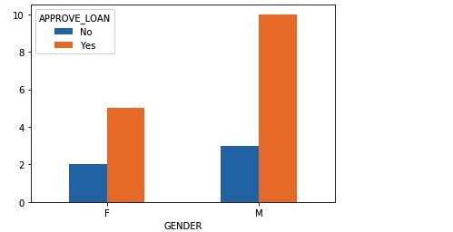
Two Categorical or Discrete Variables
Visualization - Grouped Chart
Multiple bars for each category are grouped together to facilitate comparison between different groups within each category (one categorical in X, the count in Y, and the other categorical in color).
Example: Company wants to automate the loan eligibility process based on customer details. These details are Gender, Marital Status, Education, Number of Dependents, Income, Loan Amount, Credit History and others. Let’s look at the loan approval according to gender (M, F in our data).
If the proportions of approvals (Yes/No) are similar between the genders, it suggests that gender might not be a significant factor influencing the loan approval decision.

Slide 13
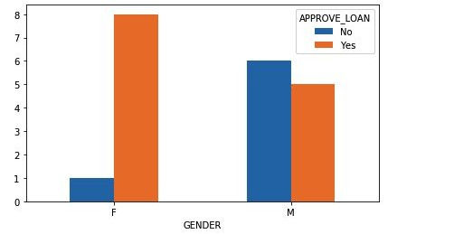
Two Categorical or Discrete Variables
Visualization - Grouped Chart
Example: let’s look at another loan approval according to gender (M, F in our data).
Here, the disparity in approval ratios is evident.
If you're female, your loan is more likely to be approved.
On the other hand, for males, the odds of approval are roughly even.
The data suggests a correlation between gender and loan approval rates.

Slide 14
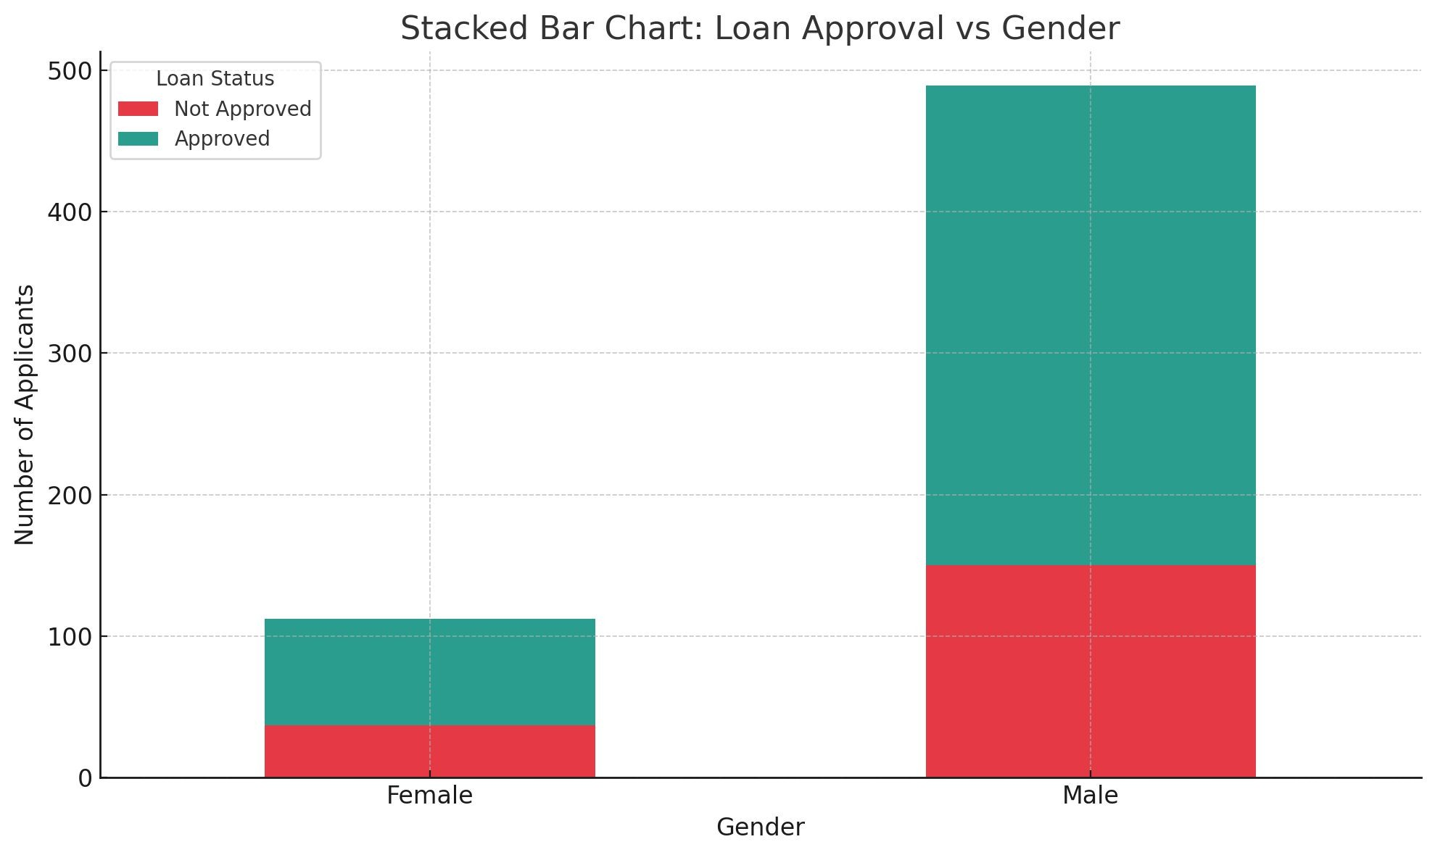
Two Categorical or Discrete Variables
Visualization - Stacked Chart
Each bar is divided into multiple sub-categories, allowing for comparison of the overall category size as well as the proportions of its sub-categories.
Visually, the proportion of approvals seems relatively consistent between the two genders, with perhaps a slightly higher proportion for males.
This suggests that, while there might be some variation, gender might not be a significant factor in the loan approval process.
However, a deeper statistical analysis would be needed to confirm this observation.

Slide 15
Bivariate Analysis
Numerical Continuous Variables

Slide 16
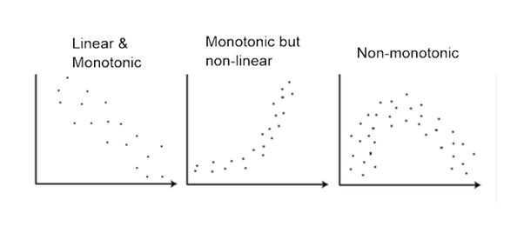


Two Numerical Continuous Variables
Correlation Coefficients
One of the primary tools used to measure the strength and direction of the relationship between two continuous numerical variables is the correlation coefficient.
Pearson's: for linear relationships.
Spearman's: for monotonic relationships.

Slide 17
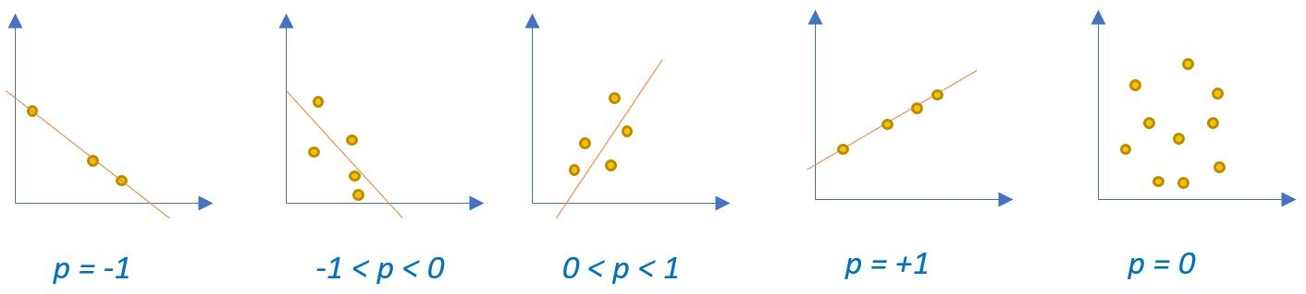
Two Numerical Continuous Variables
Correlation Coefficients
Pearson's: for linear relationships.
Positive values: As one variable increases, the other also tends to increase.
Negative values: As one variable increases, the other tends to decrease.
The magnitude (absolute value) indicates the strength. Closer to 1 or −1 means a stronger relationship, while closer to 0 indicates a weaker relationship.
* Careful with outliers!

Slide 18
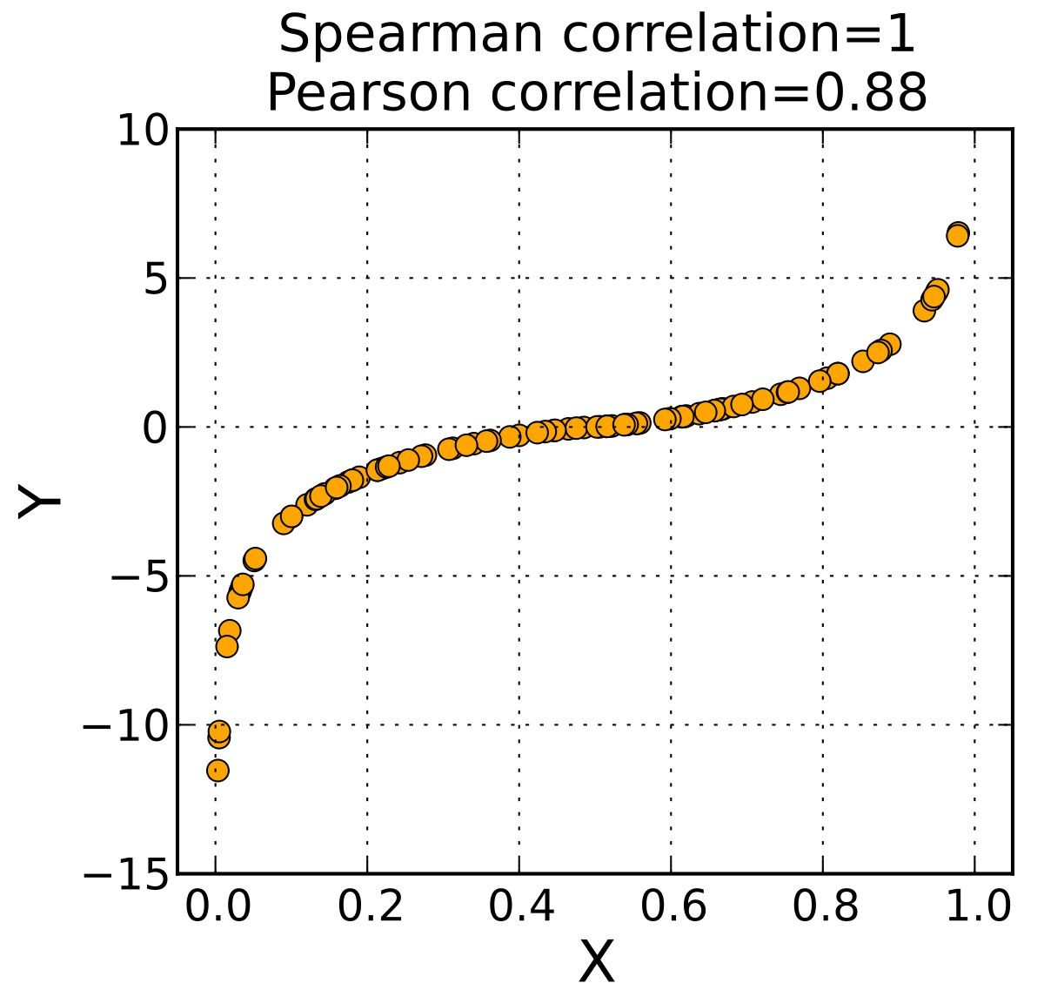
Two Numerical Continuous Variables
Correlation Coefficients
Spearman's: for monotonic relationships.
Positive values: As one variable increases, the other also tends to increase, but not necessarily at a constant rate.
Negative values: As one variable increases, the other tends to decrease, but not necessarily at a constant rate.
* Careful with outliers!

Slide 19
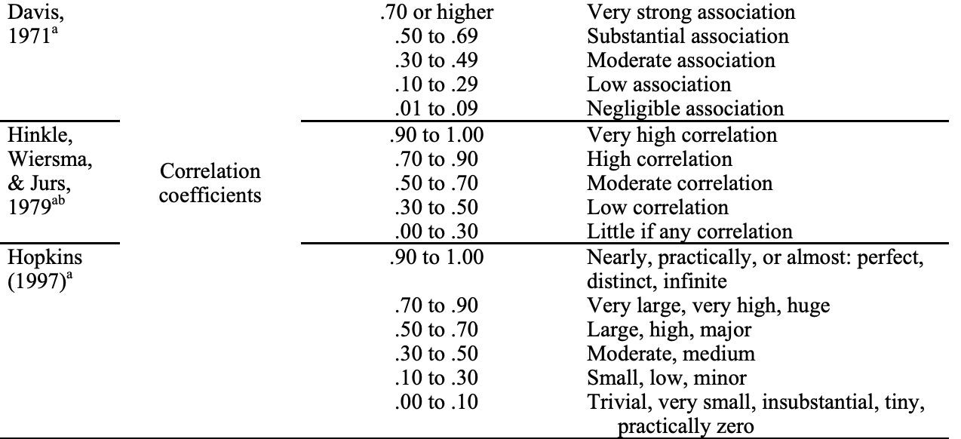
Two Numerical Continuous Variables
Correlation Coefficients

Slide 20
Two Numerical Continuous Variables
Correlation Coefficients and p-values
The correlation coefficient itself doesn't tell us whether the observed relationship in the sample data is statistically significant in the population.
We need to also check the p-value. In this case, It tests the null hypothesis that there's no relationship between the two variables in the population - we will explain in detail about how this works soon.
P-value < 0.05: This suggests that the observed correlation in the sample is statistically significant and is unlikely to have occurred by random chance (we reject the null hypothesis.)
P-value > 0.05: This suggests that the observed correlation in the sample is not statistically significant and could have occurred by random chance (we fail to reject the null hypothesis)
Note: A p-value of 0.05 means that there is only 5% chance that results from your sample occurred due to chance. A p-value of 0.01 means that there is only 1% chance.

Slide 21
Two Numerical Continuous Variables
Correlation Coefficients - Example
In Eldoria, a local company is studying its famous coffee beans. They're tracking "Color Intensity" to gauge a bean's strength and using "Time of Day" to see when people drink their coffee. The "Energy Boost" measure shows the general power of a bean based on its color, while "Energy Boost over Time" focuses on the specific effects of the special "Golden Eldoria Bean" throughout the day. With this data, the company aims to better understand its product and serve its customers.
Is there a relationship between the color intensity of the beans and the energy boost they provide?
Pearson Correlation Coefficient: 0.8317
Spearman Correlation Coefficient: 0.8299
Both correlation coefficients indicate a strong positive association. The values being close to each other and above 0.8 imply that as the color intensity of the beans increases, the energy boost they offer also generally increases.
 | Color Intensity | Energy Boost | Time of Day | Energy Boost over Time
0 | 9.45 | 8.80 | 22.55 | 0.66
1 | 3.55 | 2.34 | 6.79 | 14.84
... | ... | ... | ... | ...

Slide 22
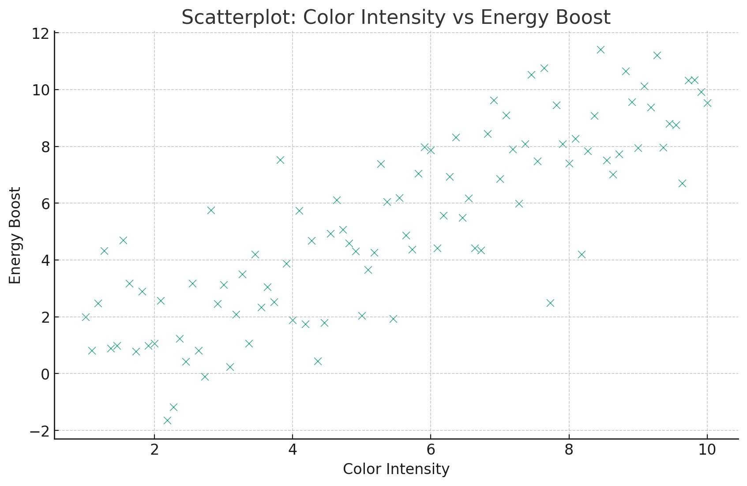
Two Numerical Continuous Variables
Visualization - Scatter Plots
Visual representation of the relationship between two numerical variables. Each point represents a single observation. The position of a point is determined by its values for the two variables being plotted (like coordinates).
Is there a relationship between the color intensity of the beans and the energy boost they provide?

Slide 23
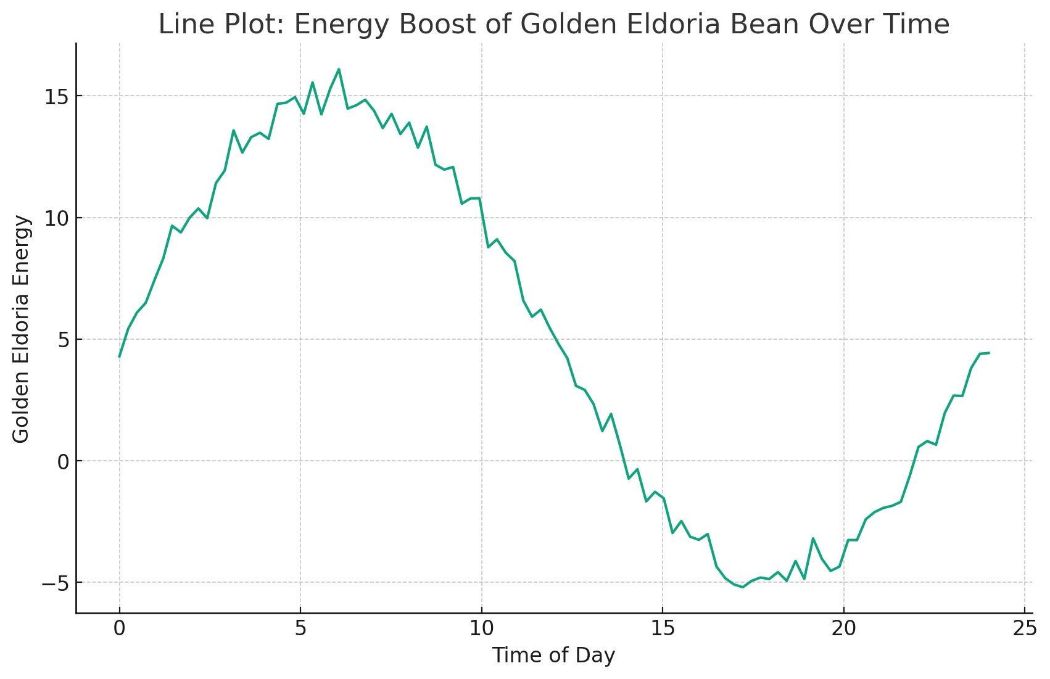
Two Numerical Continuous Variables
Visualization - Line Plots
…A line plot displays information as a series of data points connected by straight line segments. It is often used to visualize a trend in data over intervals of time – hence its frequent use with time series data.
How does the energy boost from the "Golden Eldoria Bean" vary over the course of a day?

Slide 24
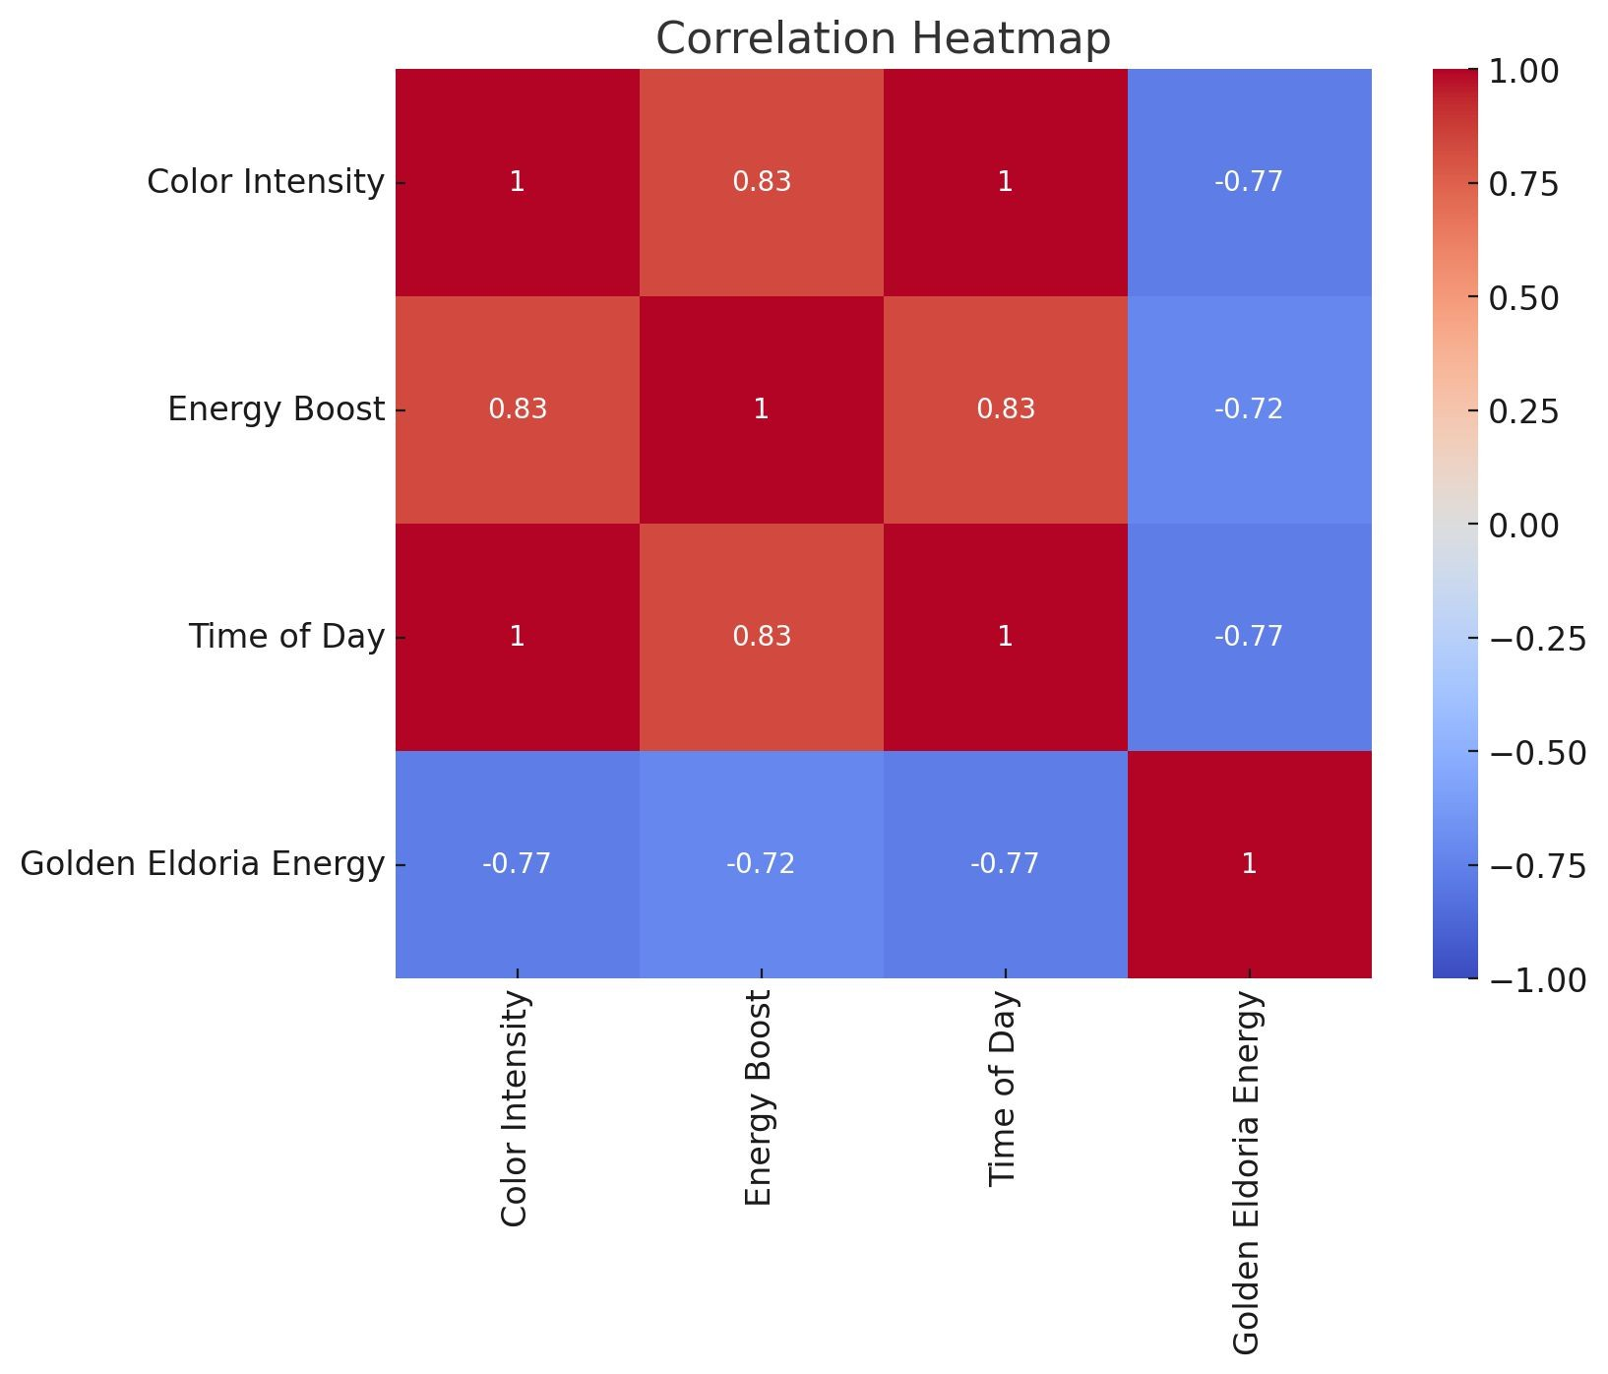
Two Numerical Continuous Variables
Visualization - Correlation Heatmaps
A correlation heatmap uses a color scale to represent the correlation coefficients between pairs of variables in a matrix format. It allows for a quick visual assessment of relationships (or lack thereof) between multiple variables.
How do different variables correlate with each other?

Slide 25
Two Numerical Continuous Variables
Visualization - QQ Plots
QQ plots, or Quantile-Quantile plots, are used to help assess if a dataset follows a certain theoretical distribution. Is done by plotting their quantiles against each other. If the two distributions being compared are similar, the points in the QQ plot will approximately lie on the line y=x.
Normality Testing: One of the most common uses. In this case, the data quantiles are plotted against the quantiles of a standard normal distribution.
Comparing Distributions: Besides the normal distribution, you can use QQ plots to see if your data fits other theoretical distributions like exponential, t-distribution, etc.

Slide 26
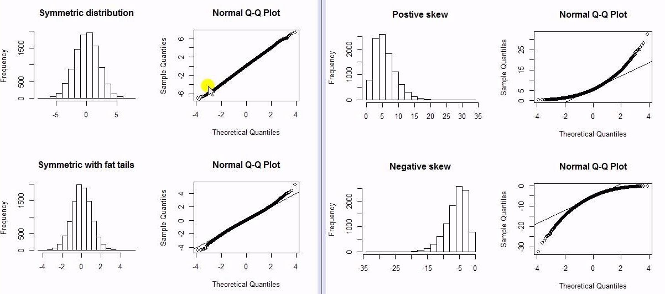
QQ - Plot

Slide 27
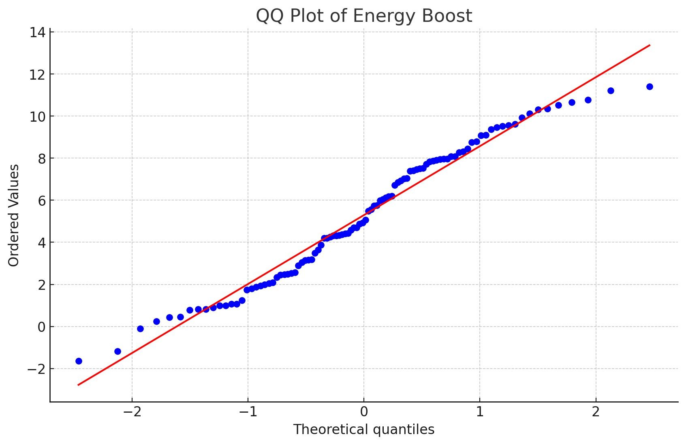
Two Numerical Continuous Variables
Visualization - QQ Plots
Is 'Energy Boost' data normally distributed?

Slide 28
Bivariate Analysis
Numerical Continuous VS Categorical/Discrete Variables

Slide 29
Numerical Continuous VS Categorical Variables
Summary Statistics by Category
When you want to compare a numerical continuous variable with a discrete or categorical variable numerically, you're essentially trying to understand how the continuous variable's values differ across the levels or categories of the discrete variable.
Calculate measures of centrality (like mean or median) and spread (like standard deviation or IQR) for the continuous variable within each category.
For instance, if you're comparing exam scores (continuous) by grade level (categorical), you might compute the mean score for each grade.
You could also transform the continuous variable to categorical or vice-versa if it’s what your analysis needs.

Slide 30
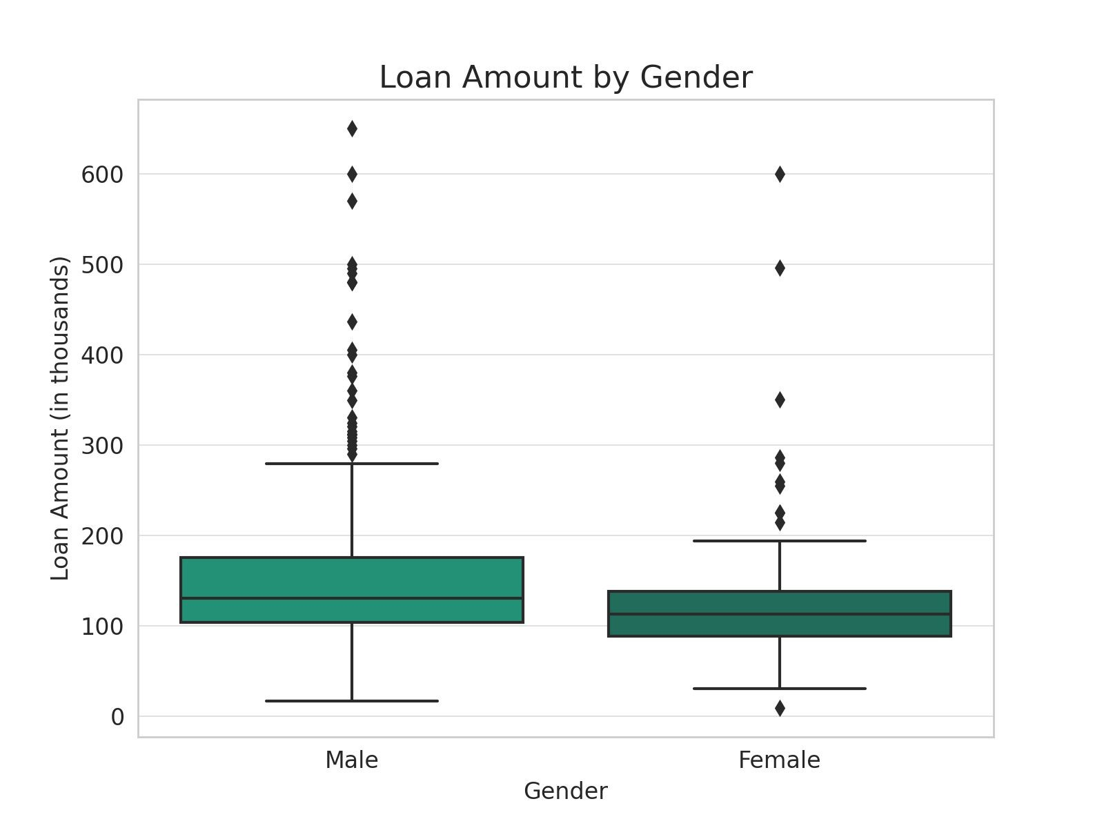
Numerical Continuous VS Categorical Variables
Visualization - Side by Side Box plots
Show distributions of the numerical variable (axis Y) across categories (axis X).
Example: let’s look again at the previous example about the loan approval according to gender.
Is there any significant difference in the loan amounts requested by males and females?

Slide 31
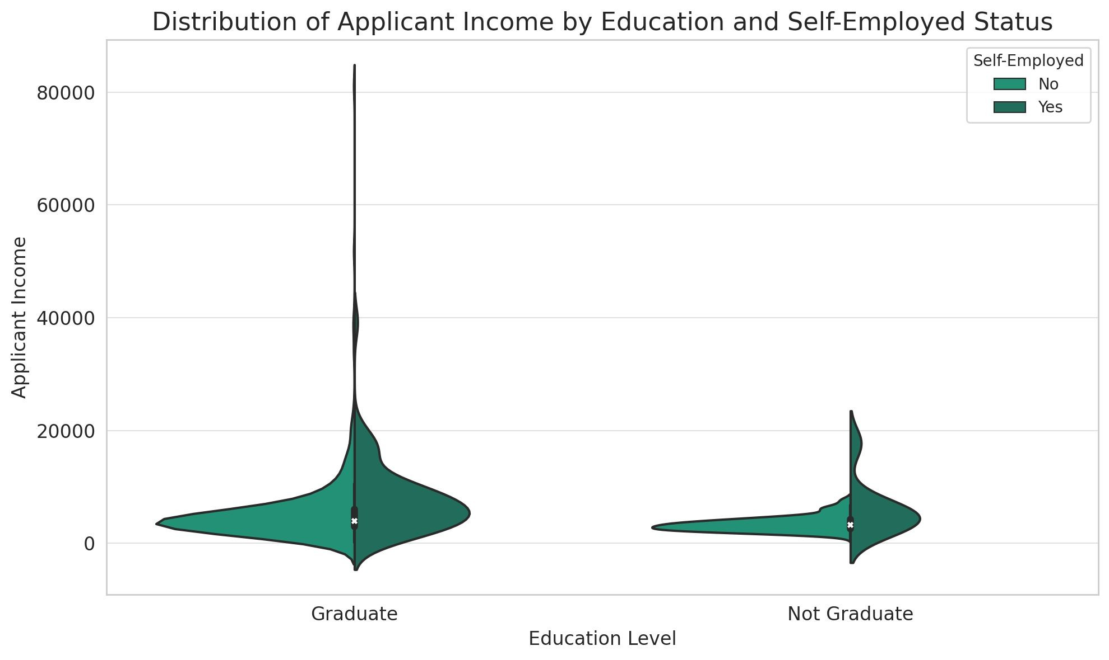
Numerical Continuous VS Categorical Variables
Visualization - Violin plots
Combine aspects of box plots and density plots.
How does the distribution of applicant income vary based on education and whether they are self-employed?

Slide 32
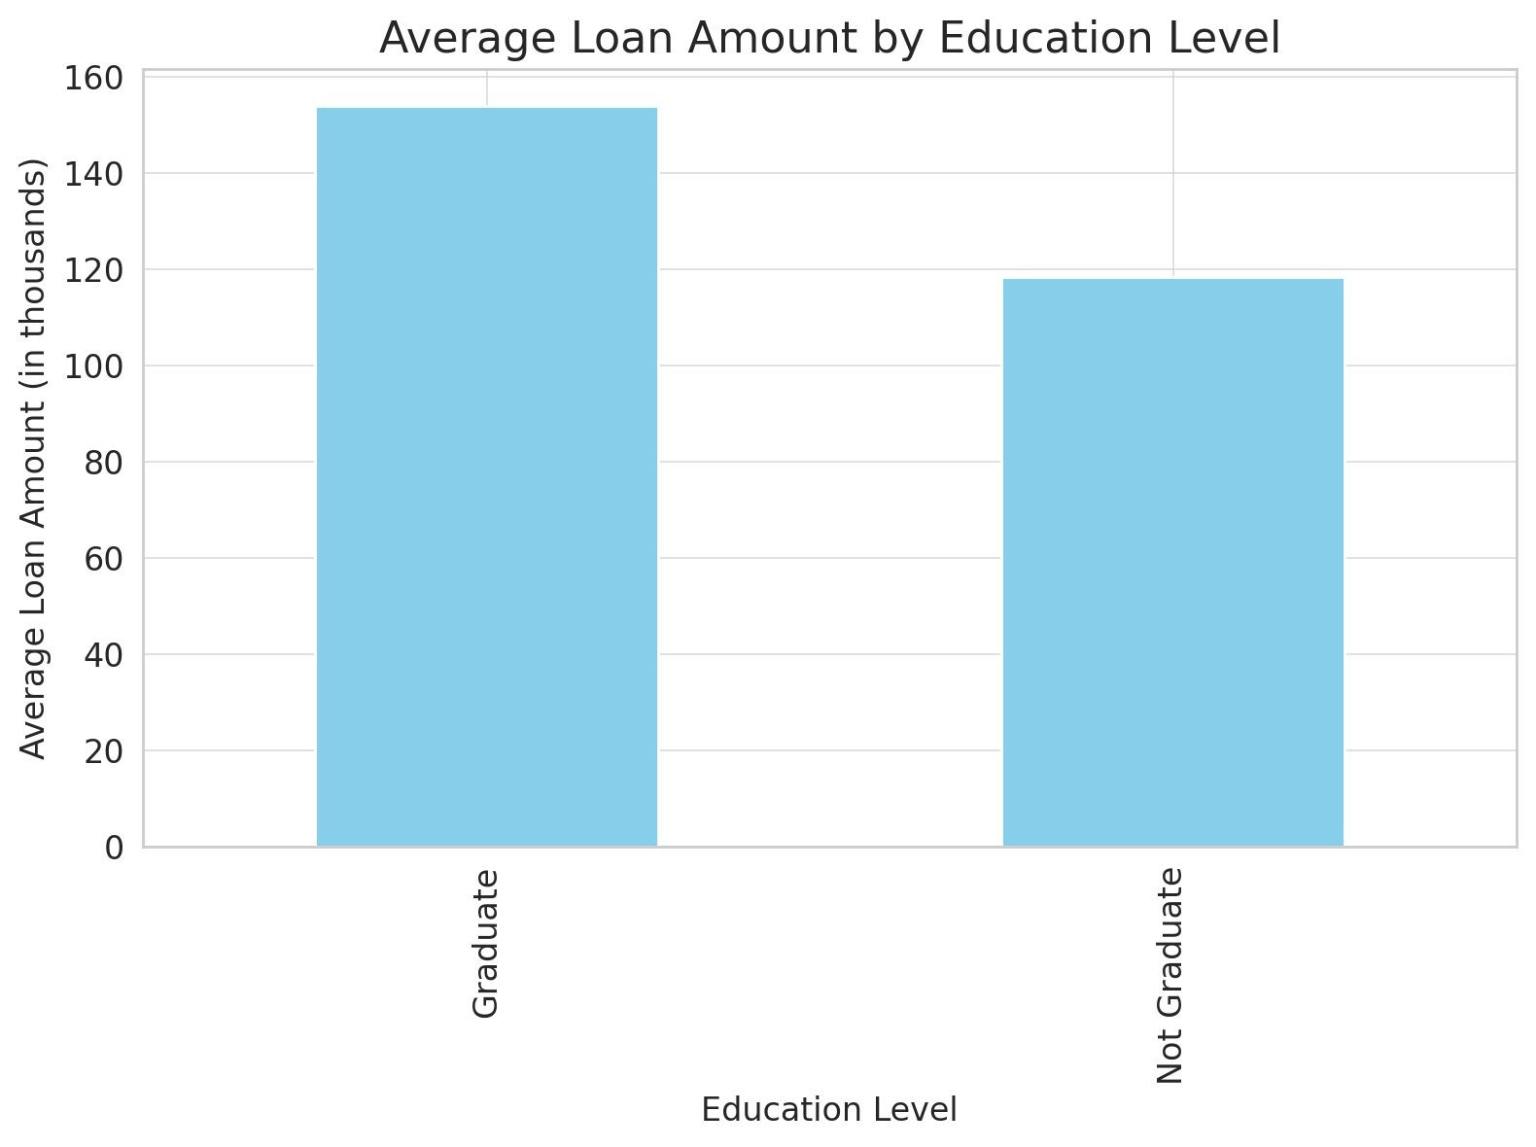
Numerical Continuous VS Categorical Variables
Visualization - Bar Charts
If in the Y-axis instead of the count or frequency for the categories, we show the mean -or another measure of central tendency- of the continuous variable for each category (X-axis).
What is the average loan amount requested by applicants based on their education level?

Slide 33
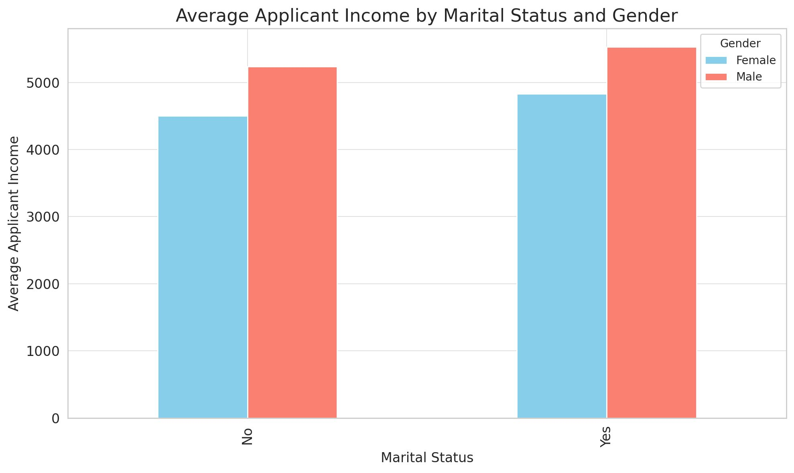
Numerical Continuous VS Categorical Variables
Visualization - Grouped Bar Charts
We can use grouped bar charts to visualize the relationship between a categorical (X) and a continuous variable (Y) –instead of count in Y-, differentiated by color by another categorical variable.
How does the average applicant income vary based on their marital status, differentiated by gender?

Slide 34
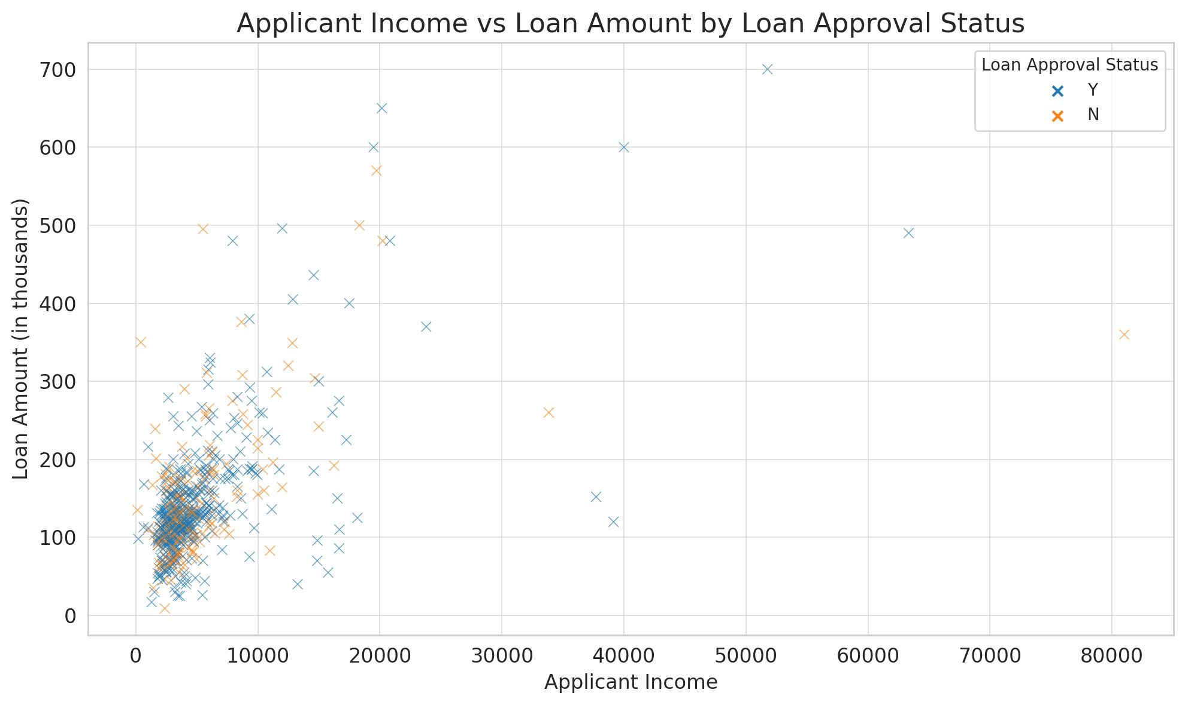
Numerical Continuous VS Categorical Variables
Visualization - Scatter Plots
We can use a scatter plot to visualize the relation between a continuous (X) with a continuous Y,
differentiated by color by a categorical variable.
How does the applicant income relate to the loan amount requested, differentiated by loan approval status?

Slide 35
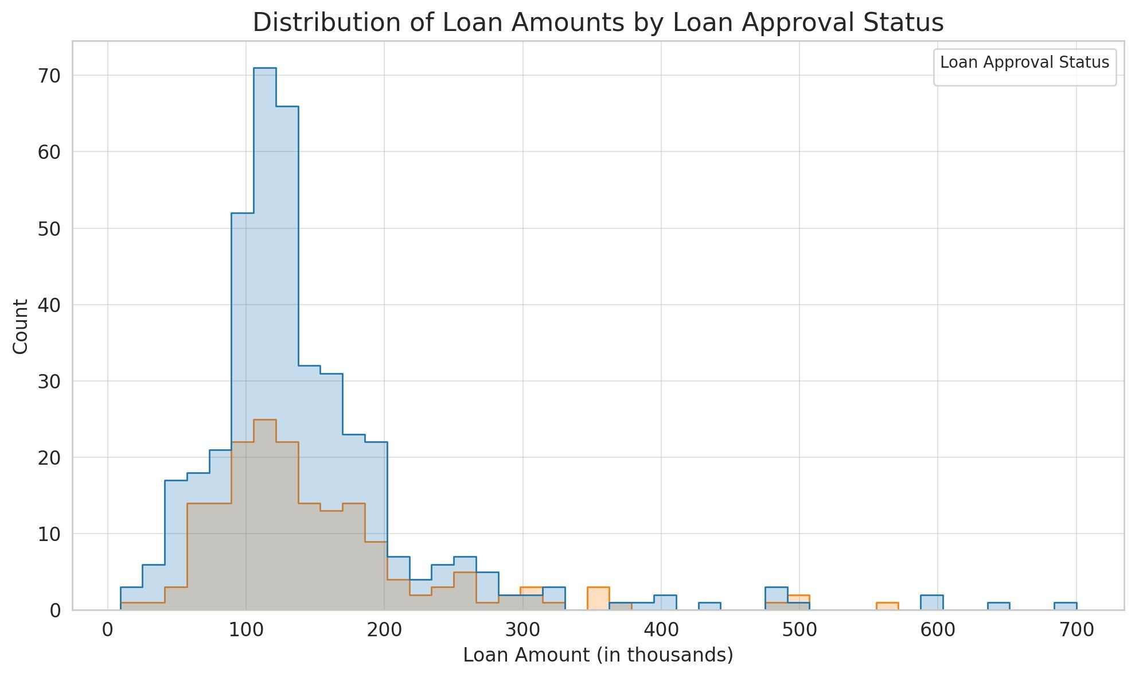
Numerical Continuous VS Categorical Variables
Visualization - Grouped Histogram
We can use grouped histogram to visualize the relation between a continuous (X) its count in Y,
differentiated by color by a categorical variable.
How is the distribution of loan amounts requested by applicants, differentiated by their loan approval status?

Slide 36
Outliers

Slide 37

Outliers
What is an Outlier?
An outlier is an observation that appears to deviate markedly from other members of the sample in which it occurs. In simpler terms, it's a value that is considerably different from most of the other values in your dataset.
Causes of Outliers
Measurement or Input Error: Mistakes can happen during data collection, recording, or entry.
Data Processing Error: Incorrect calculations or data manipulation.
Natural Variations: Genuine variations in data.
Intentional Outliers: Purposely inserted anomalies to flag special attention (such as missing values).
Changes Over Time: Evolving data values make old ones appear unusual.
Fraudulent or Malicious Activity: Deceptive actions causing data irregularities.

Slide 38
Outliers
Techniques to Identify Outliers
Visual Inspection
Box Plots: The whiskers in a box plot often extend 1.5 times the interquartile range (IQR). Data points outside this range can be considered outliers.
Histograms: Outliers may manifest as isolated bars or peaks distant from the main data distribution.
Scatter Plots: Outliers will appear as points that are far away from the cluster of other data points.
Statistical Methods
IQR Method: Calculate the IQR (difference between 75th percentile and 25th percentile). Any data point outside [Q1−1.5×IQR,Q3+1.5×IQR] can be considered as outliers.
Standard Deviation Method: If a data point is more than n standard deviations away from the mean, it can be considered an outlier. Common values for n are 2 or 3.
Machine Learning
Algorithms like DBSCAN, Isolation Forest, and One-Class SVM can detect outliers.

Slide 39
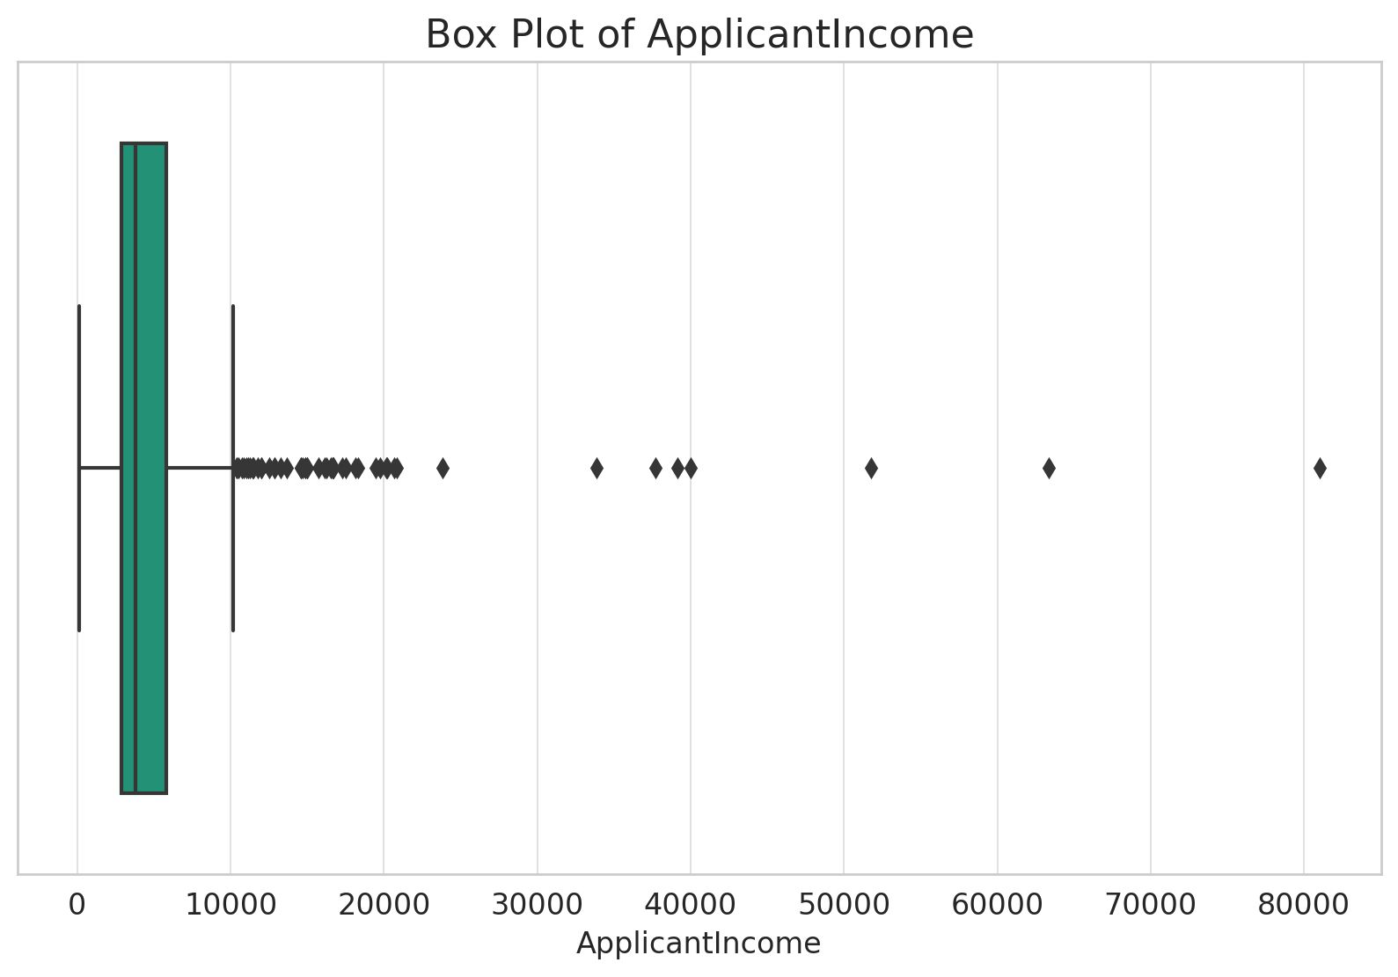
Outliers
Techniques to Identify Outliers - Loan Approval Example
To identify outliers, we will focus on a numerical column. Let's choose ApplicantIncome for this purpose.
1. Visual Inspection
Box Plots
Histograms
Scatter Plots
Outliers can often be identified as points outside the "whiskers" or ends of the box plot.

Slide 40
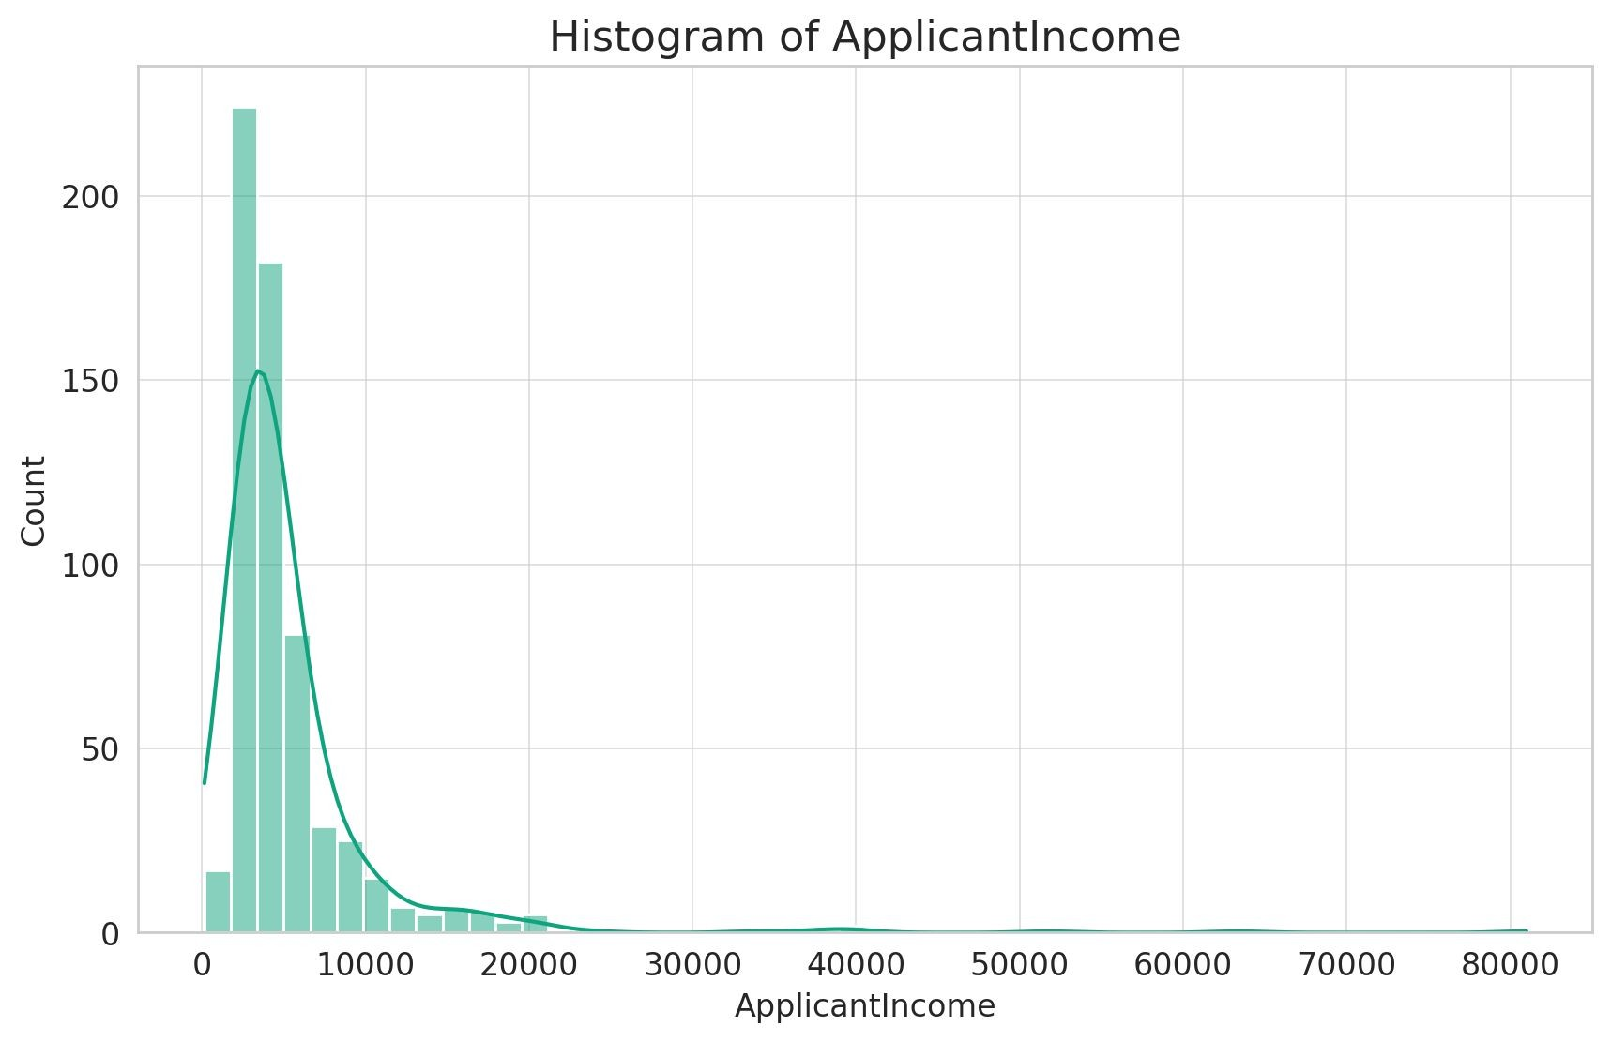
Outliers
Techniques to Identify Outliers - Loan Approval Example
To identify outliers, we will focus on a numerical column. Let's continue with ApplicantIncome.
1. Visual Inspection
Box Plots
Histograms
Scatter Plots
A histogram represents the distribution of a dataset. Outliers can sometimes be visualized as isolated bars far from the central data cluster.

Slide 41
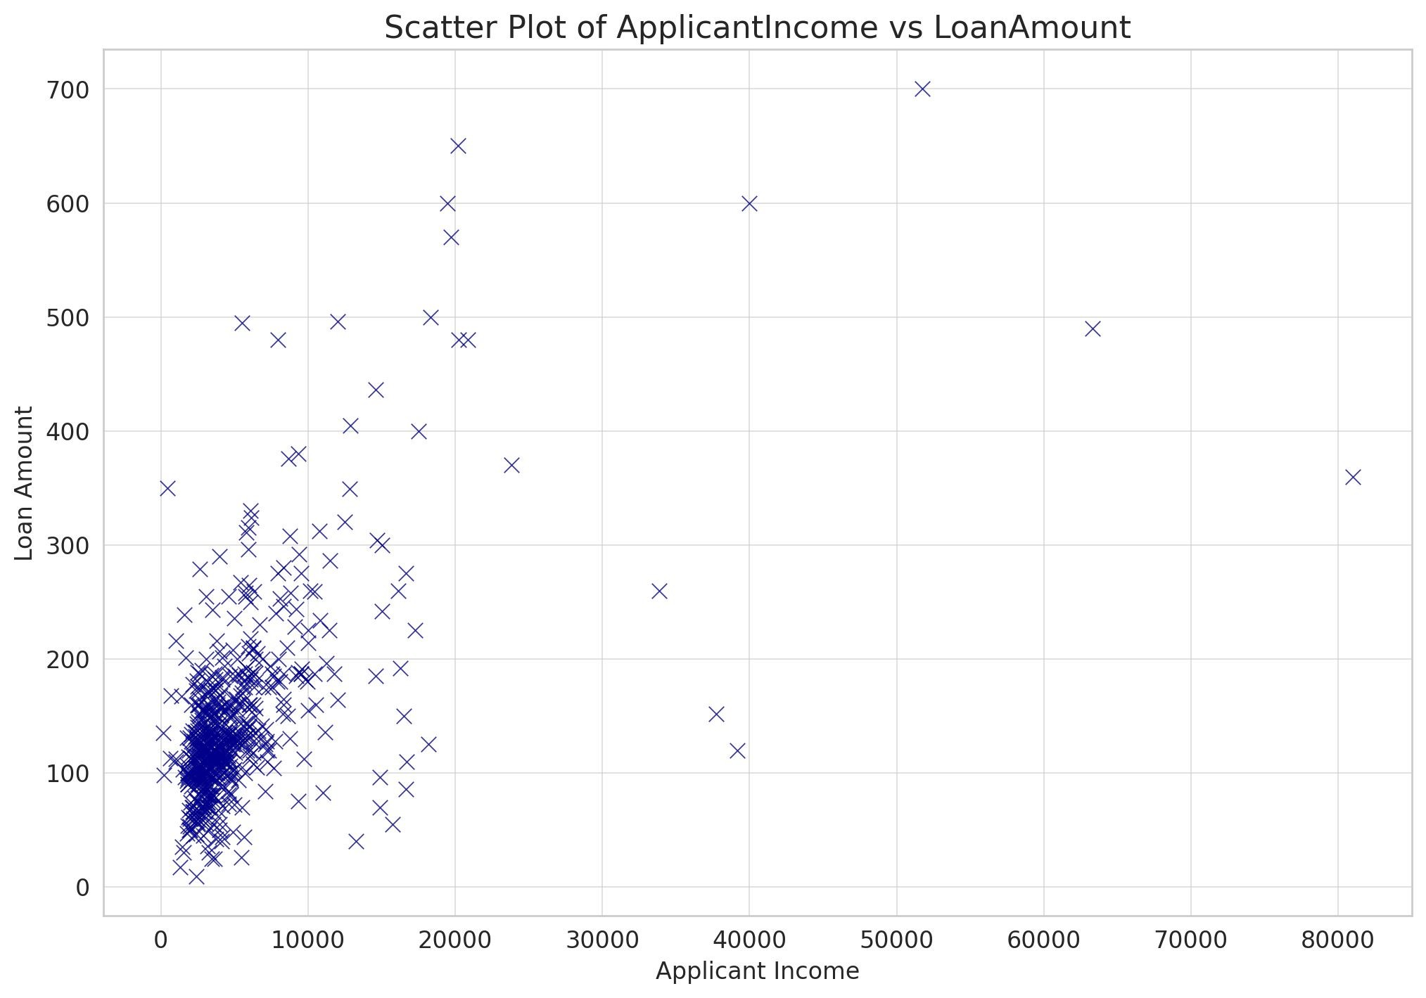
Outliers
Techniques to Identify Outliers - Loan Approval Example
For a Scatter Plot, we need two numeric continuous variables. Let's create a scatter plot comparing
ApplicantIncome against LoanAmount to identify potential outliers.
Visual Inspection
Box Plots
Histograms
Scatter Plots
By using scatter plots, you can visually inspect and identify potential outliers as isolated data points when comparing two numerical variables.

Slide 42
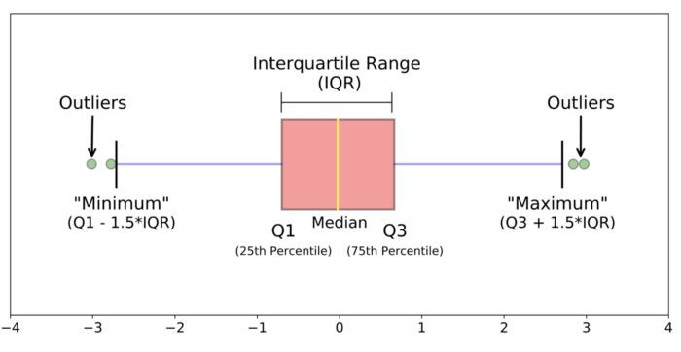

Outliers
Techniques to Identify Outliers - More Detail
Statistical Methods
IQR Method (Tukey’s Method)
Standard Deviation Method
Same as through box plots but with numerical calculations: we calculate the IQR (Q3 - Q1). Any data point outside the range can be considered as outliers.
The 1.5 multiplier (scale) is standard for outlier detection. Alternatives include:
1.0: Aggressive, will identify more points as outliers. It might be used when we want to be more conservative and ensure we're capturing potential anomalies, especially in datasets with fat tails.
2.0 or 3.0: More forgiving thresholds, reduces the number of identified outliers. This might be used in cases where the data is known to have wide variations but these are still considered typical.
This number, the scale, depends on the distribution followed by the data.

Slide 43
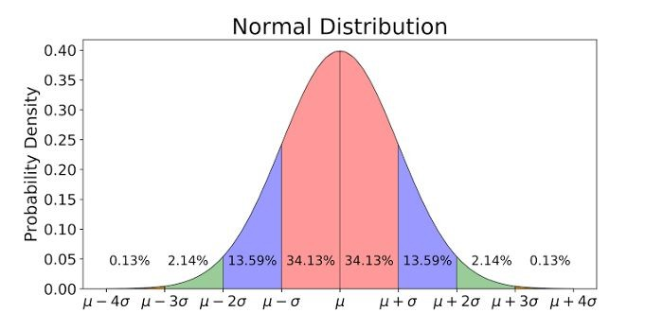
Outliers
Techniques to Identify Outliers - More Detail
Statistical Methods
IQR Method (Tukey’s Method)
Standard Deviation Method
This method is used if our data is normally distributed. If it's not our case, we then use the IQR method, or transform our data (log, square root, or Box-Cox - will talk about this later) to make it more normal-like before applying the standard deviation method.
If a data point is more than n standard deviations away from the mean, it can be considered an outlier. A common threshold is n=3 since for a dataset that is approximately normally distributed:
About 68% of the data lies within 1 standard deviation of the mean.
About 95% lies within 2 standard deviations.
About 99.7% lies within 3 standard deviations.

Slide 44
Outliers
Techniques to Identify Outliers - More Detail
Why 1.5?
The 1.5 multiplier in the IQR outlier detection is inspired by the normal distribution characteristics, although the IQR method doesn't require the data to be normal.
Upper Bound := Q3 + 1.5 * IQR
= Q3 + 1.5 * (Q3 - Q1)
= 0.675σ + 1.5 * (0.675 - [-0.675])σ
= 0.675σ + 1.5 * 1.35σ
= 2.7σ
Same for lower bound
Using the 1.5 multiplier, the IQR method flags data points beyond 2.7σ from the mean as outliers. This threshold is close to the normal distribution's 3σ rule for outliers, aligning the IQR method with common outlier detection practices in normally distributed data.
Note: Q1 (the first quartile) represents the 25th percentile. This means 25% of the data is below this point. When you look up this percentile in a standard normal distribution table or use statistical software to get the z-score, it corresponds to approximately -0.675. Same reasoning for Q3 and +0.675.

Slide 45
Outliers
What to do with Outliers?
Investigate: Before making a decision, understand why the outlier exists. It might offer a new insight or indicate an error.
Keep: If the outlier is a result of natural variation and is important for analysis, keep it.
Remove: If it's due to an error or it biases the analysis, consider removing it.
Transform: Apply transformations like log or square root to dampen the impact of the outlier.
Separate Analysis: Analyze outliers separately if they represent a different group or phenomenon.
Using Different Analysis Techniques: You could also use different statistical techniques or Machine Learning models that are not as much impacted by the presence of outliers.

Slide 46
Why visualizations

Slide 47
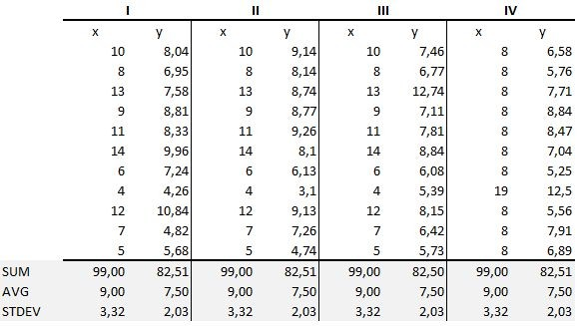



Visualization Techniques
Example: Anscombe’s quartet
It comprises four different datasets that have nearly identical measures of centrality (mean) and dispersion (variance) for both x and y variables.

Slide 48
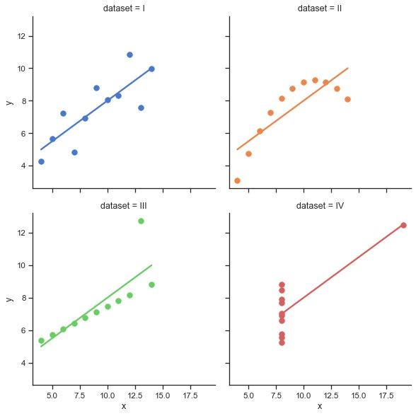
Visualization Techniques
Example: Anscombe’s quartet

Slide 49
Summary

Slide 50
Recap - Summary
Univariate Analysis: Focuses on a single variable
Categorical variables:
Frequency tables. Counts and proportions.
Visualizations: Bar charts, pie charts
Numerical variables:
Measures of centrality:
Mean, median, mode
Measures of dispersion:
Variance, standard deviation, minimum, maximum, range, quantiles
Shape of the Distribution:
Symmetry and kurtosis
Visualizations: Histograms, box plots

Slide 51

Summary
Bivariate Analysis: Examines the relationship or association between two variables.
Type of Variables (VS) | Categorical (incl. Discrete numerical) | Continuous
Categorical (incl. Discrete numerical) | Crosstab Chi-square tests Cramér's V Stacked Grouped bar charts Frequency heat maps | Violin Plots Bar Charts (Shows the mean -or another measure of central tendency- of the continuous variable for each category) Side by side Box Plots
Continuous | Violin Plots Bar Charts (Shows the mean -or another measure of central tendency- of the continuous variable for each category) Side by side Box Plots | Correlation coefficients, Covariance Regression analysis, Coefficient of Determination Scatter plots Line plots Correlation Heatmaps QQ Plot
Note: numerical techniques are in this colour.

Slide 52
Summary
Type of Variables (VS) | Method/Technique | One-Line Description
Categorical (incl. Discrete numerical) VS Categorical | Crosstab | A table showing the frequency of occurrences for combinations of two categorical variables.
 | Chi-square tests | Tests the independence of two categorical variables by comparing observed frequencies to expected frequencies.
 | Cramér's V | Measures the strength of association between two categorical variables.
 | Stacked or grouped bar charts | Visualizes the frequency or proportion of categories between two categorical variables.
 | Frequency heat maps | Displays frequencies using color gradients for combinations of two categorical variables.
Categorical VS Continuous | Violin Plots | Combines a box plot with a kernel density plot to show the distribution of a continuous variable for each category.
 | Bar Charts | Shows the mean (or another measure of central tendency) of the continuous variable for each category.
 | Side by side Box Plots | Displays the distribution of the continuous variable for each category, showing quartiles and potential outliers.
Continuous VS Continuous | Correlation coefficients, Covariance | Quantifies the strength and direction of the relationship between two continuous variables.
 | Regression analysis, Coefficient of Determination | Describes the relationship between two continuous variables and measures how well the regression line fits the data.
 | Scatter plots | Plots individual data points based on their values for two continuous variables to visualize relationships.
 | Line plots | Connects individual data points with lines, typically used to represent sequences or time series data.
 | Correlation Heatmaps | Visualizes correlation coefficients between pairs of continuous variables using color gradients.
 | QQ Plot | Compares the quantiles of a variable's distribution to the quantiles of a standard normal distribution.

Slide 53
Bonus

Slide 54
Normal Distribution
Checking if data is normally distributed
Visual Inspection:
Histogram: A bell-shaped curve in a histogram is indicative of a normal distribution.
Q-Q Plot: In this plot, the quantiles of your data are plotted against the quantiles of a normal distribution. If the data is normally distributed, the points should roughly lie on the y=x line.
Box Plots: The symmetry of a box plot can give hints about data normality.
Statistical Tests:
Shapiro-Wilk Test: This is a popular test for normality. A low p-value (typically p<0.05) indicates that the data is not normally distributed.
Kolmogorov-Smirnov Test: This test compares the cumulative distribution of your data to a normal distribution. Again, a low p-value suggests non-normality.
Descriptive Statistics:
Skewness and Kurtosis: Skewness measures the asymmetry of the data distribution, while kurtosis measures the "tailedness". For a normal distribution, skewness should be close to 0 (indicating symmetry), and kurtosis should be close to 3. Should be used in conjunction with other methods.

Slide 55
Normal Distribution
Transforming Data to Be Normally Distributed
Transforming data to be approximately normal can aid in statistical analysis and modeling.
Log Transformation:
Useful for data that shows exponential growth, like population or financial data.
Use when data is right-skewed.
Square Root Transformation:
Moderates the impact of extreme values.
Suitable for data with mild skewness.
Box-Cox Transformation:
Requires positive data values.
Automatically determines the best power transformation.

Slide 56
Normal Distribution
Transforming Data to Be Normally Distributed
After Transformation:
Re-assess Distribution: After applying a transformation, visually assess the distribution again using histograms and Q-Q plots.
Statistical Testing: Shapiro-Wilk or Kolmogorov-Smirnov tests can be used to statistically assess normality.
Remember to reverse transformations (when needed) for interpretation.
Always consider the underlying reasons for any non-normality, as transformations might not always be the best solution.

Slide 57
Normal Distribution
Central Limit Theorem
The CLT states that, regardless of the shape of the underlying population, the sampling distribution of the mean will approximate a normal distribution as the sample size grows larger (n > 30), assuming all samples are identical in size and are randomly sampled.
Large Sample Size & Individual Data Points: Even with a large sample, the distribution of individual data points could still be non-normal. For instance, a dataset with millions of data points could still be heavily skewed or have extreme kurtosis.
Large Sample Size & Averages of Samples: If you're taking multiple samples from a population and calculating their averages, the distribution of those averages tends to be normal due to the CLT, even if the underlying population is not normal.
Practical Implications: While the CLT is powerful, remember that many statistical tests and methods assume that the individual data points (not their means) are normally distributed. So, you can't bypass these assumptions simply because you have a large dataset.

